Slide 1
Gene Regulatory Networks 1

Slide 2
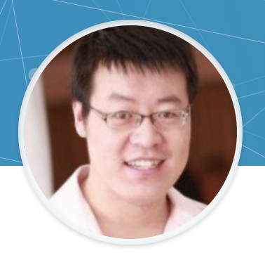
Today’s Instructor
Bioinformatics and Computational Biosciences Branch (BCBB), NIAID
National Institutes of Health, Bethesda, MD USA.
Contact our team via email:
Github: https://github.com/niaid/Gene_Regulatory_Networks
Instructors: zhuy16@nih.gov
Server: ssh username@137.63.194.9, /home/bcbb_teaching_files/
Googledoc, https://tinyurl.com/zhu-GRN
Email: bioinformatics@niaid.nih.gov
Linkedin: https://tinyurl.com/zhu-linkedin
Yunhua Zhu,
Ph.D in stem cell biology
Computational Genomics Specialist – Transcriptomics
Bachelor in biochemistry @NUS
Ph.D in stem cell biology @NUS
Postdoc in neurodegeneration, single cell biology @JHU
Bioinformatician @ NIH
Recent projects
Single cell analysis of cancer stem cells
Single cell analysis of immue response in lung cancer
Bulk RNA-seq on irradiation, HIV blood samples
PLEASE JOIN THE DISCUSSION

Slide 3
Genie3

Slide 4
Ensemble learning with random forest
A way to derive learning samples by randomly select subsets of samples and features, with replacement, to build up the knowledge.
Ensemble tree/ random forest / bagging / bootstrapping
Sample and build model (a tree)→replacement → resample and build model (another tree)→→→ … repeat thousands of times (trees) – take average of the results.
Within each sample do
Regression tree learning as in next slide.
Classification tree

Slide 5
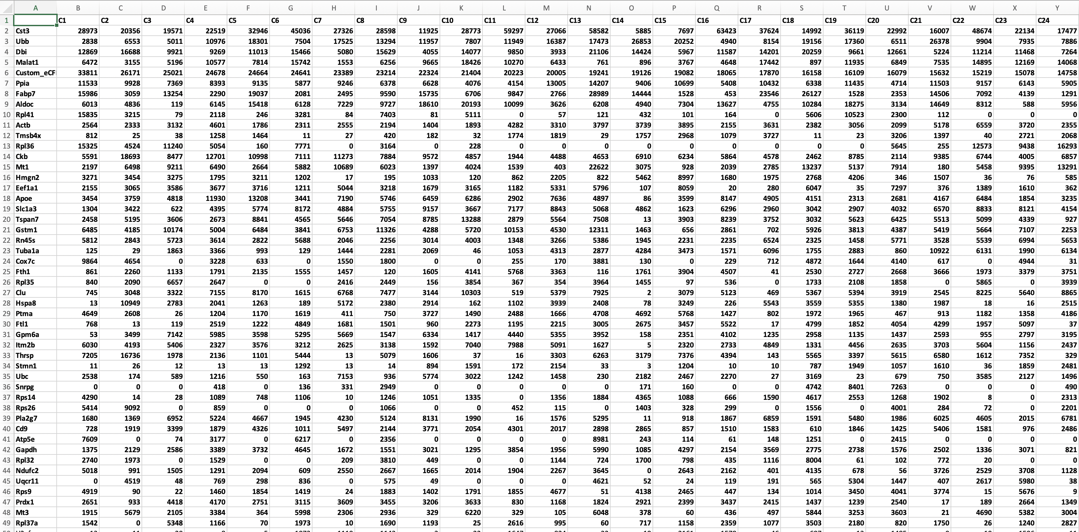
Bootstrapping/Bagging
LS 6
LS 5
LS 3
LS 2
LS 1
LS 4

Slide 6
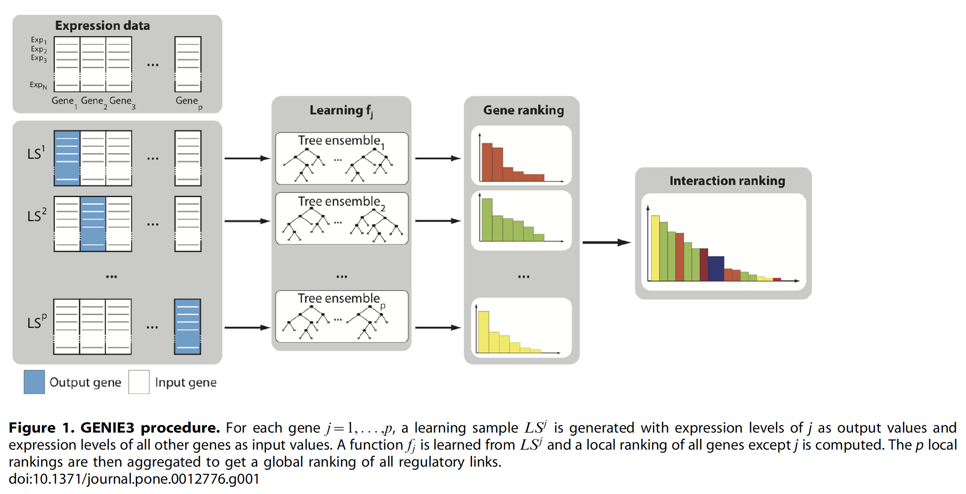
Genie3-–bootstrapping

Slide 7
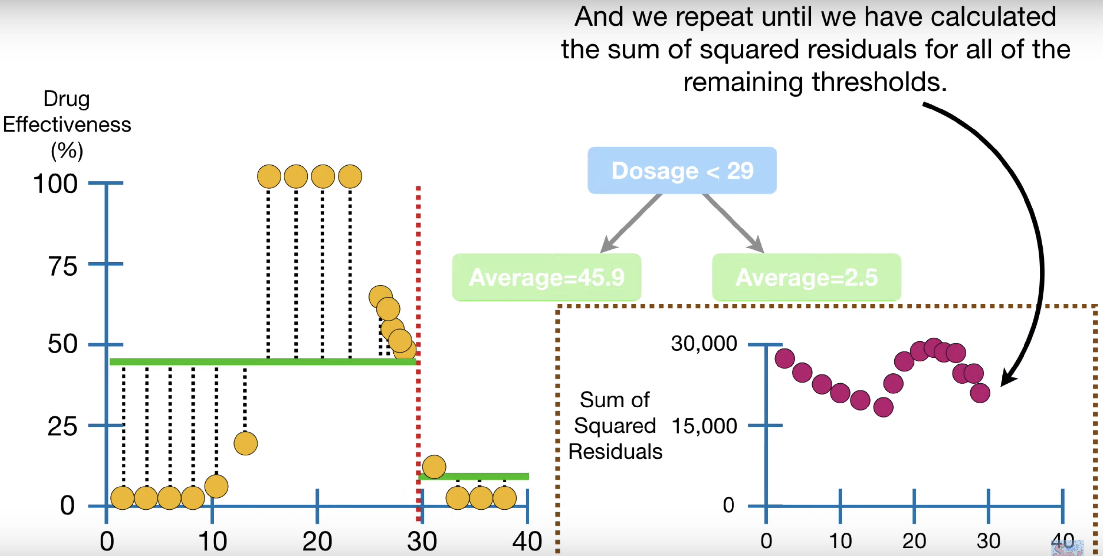
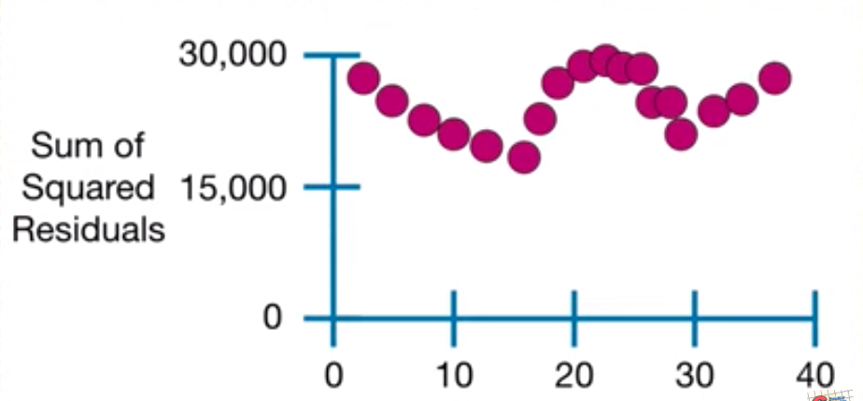
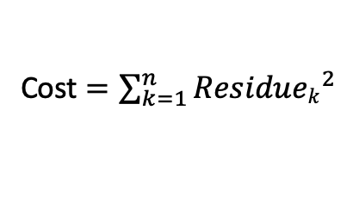
How regression tree works
Expres of target gene J
Cost $=\sum_{k=1}^{n}{{Residuek}^{2}}$
https://www.youtube.com/watch?v=g9c66TUylZ4

Slide 8
Genie3
Efficiently handle large dataset.
Implemented in R and Python
Has been joined with cis-Target to make use of publicly deposited data base to increase accuracy
Most popular package in the category of single cell RNA-sequencing.

Slide 9
iRegulon

Slide 10
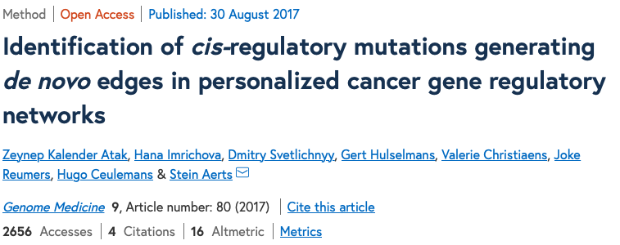
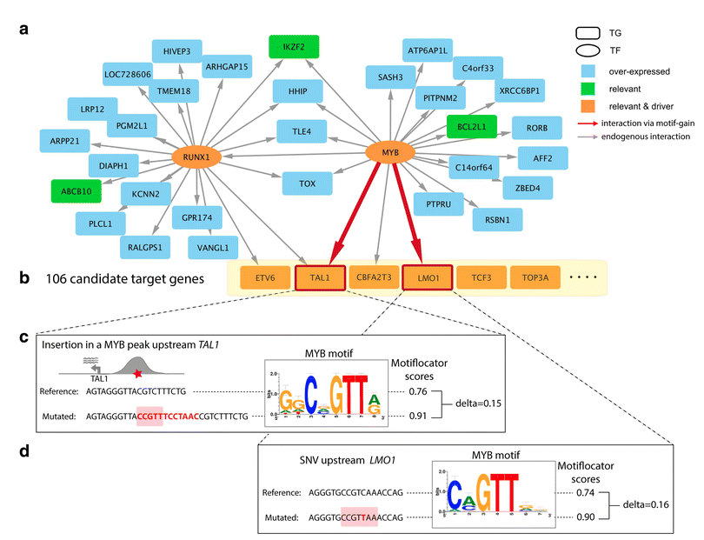
Introduction
What is iRegulon
TF activity usually correlates with its abundance
co-expression gene modules, rather than individual genes, may be more reliably reflect biology.
Allow generation of a richer hypothesis
Binding site sequence ---mutagenesis to test the TF binding.
Using real-time PCR to test the set of gene regulation by the masteragulaton
Well informed on the biology the TF will affect, for design gain- and lost- function analysis.
How to do
Tools
Graphic user interface
iRegulon
cisTarget
Commend line tools.
Kalender Atak et al. Genome Medicine (2017) 9:80

Slide 11
Why iRegulon?
TF coordinates groups of factors underlaying specific biological function.
Regulon prediction are based on multiple genes, therefore may increase the successful rate to find a important target.
iRegulon makes use of currently know knowledge about TF binding.

Slide 12
What do you need for iRegulon
Predefined list of genes
Differential gene expression at different conditions
Co-expression modules for a specific cell type
Modules of genes up/downregulated along a trajectory with pseudotime.
Often generated by clustering methods such as DEseq2, WGCNA or the Seurat package
Challenges
Regulation is usually cell type specific
Conserved binding sequence may not be a good predictor, because geneomic accessibility/epigenetics will play a role.
Downstream targets are not very reliable when you consider the cell type specificity.
It is very common that mutliple TFs binds to the same conserved sequence.
Stochasticity in detection of gene expression( drop out rate in single cell study)
Expectation is high as the downstream validation is expensive in time and money.
Direct and indirect regulations, and many other form of regulations.

Slide 13
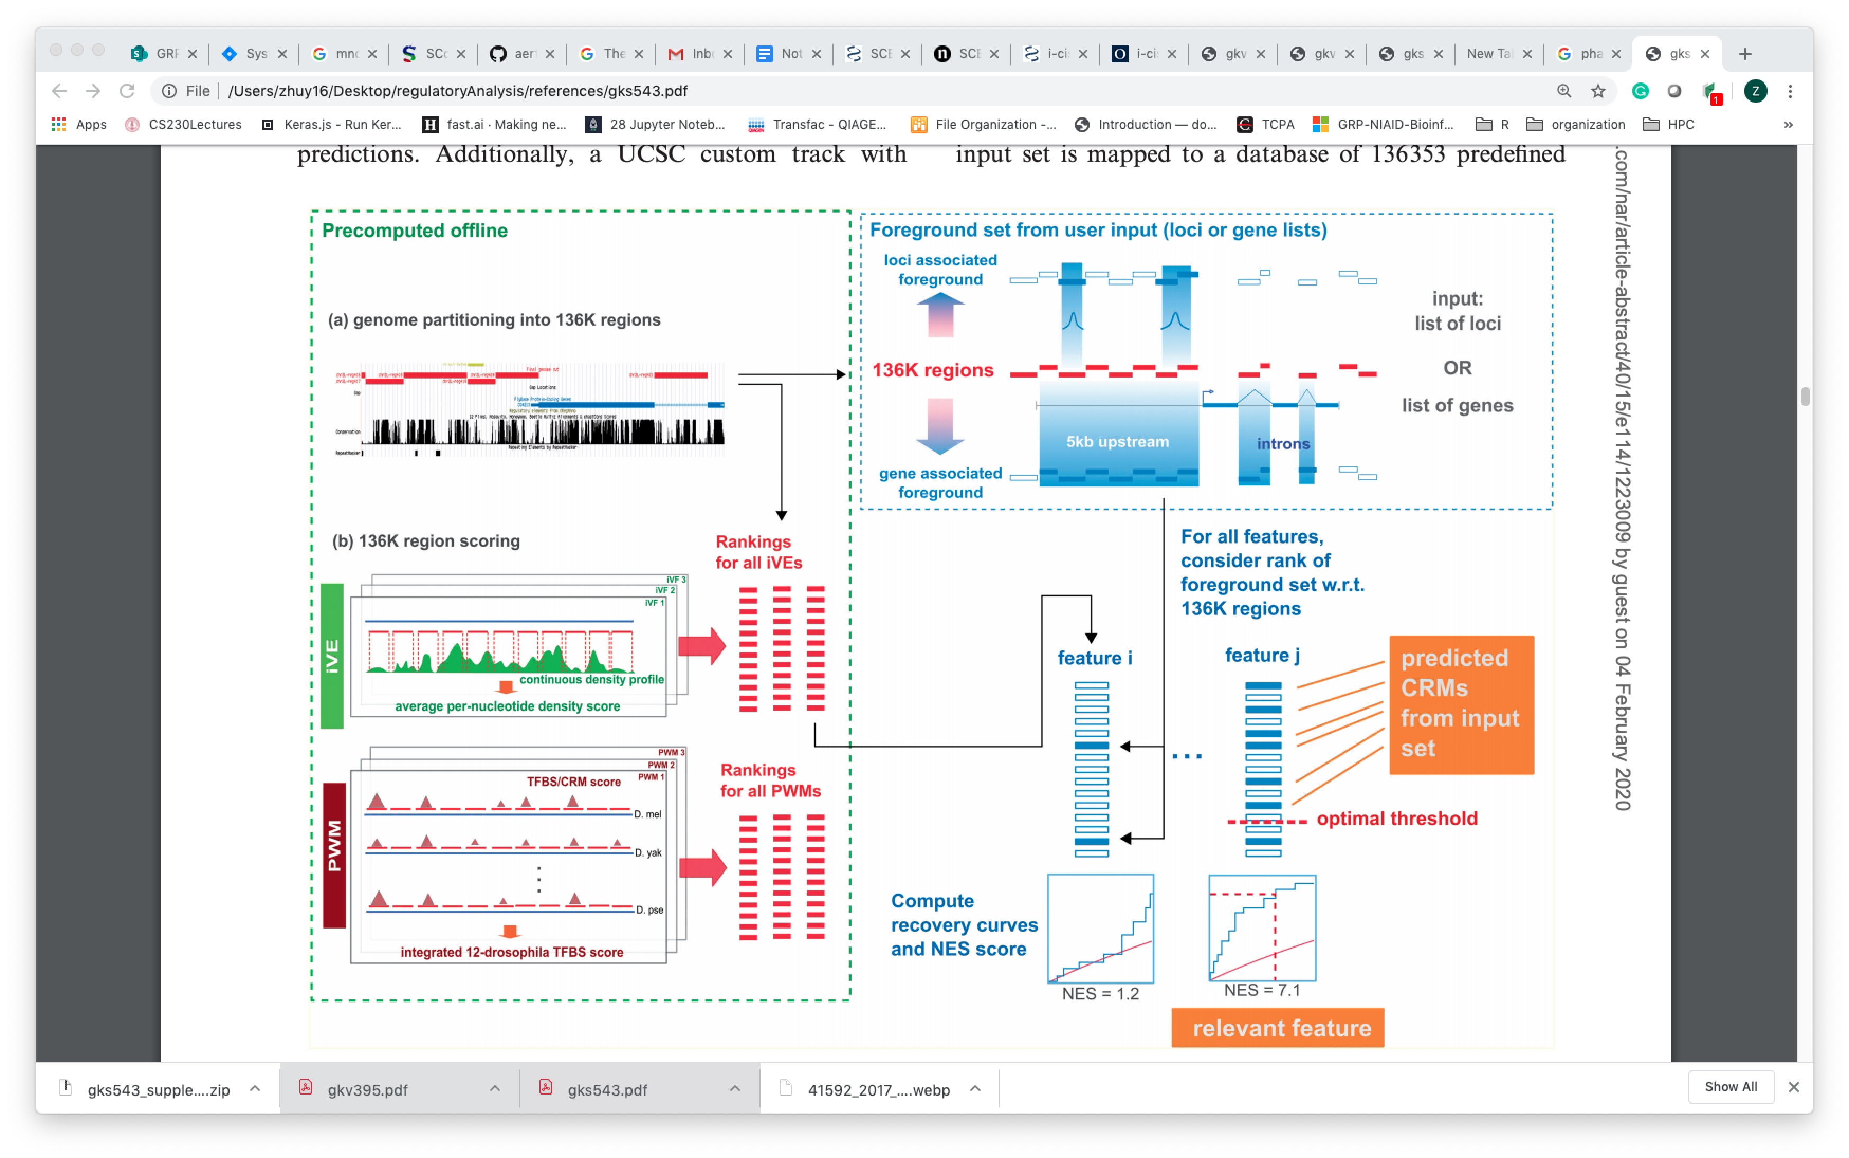
How iRegulon Work?
Database
or a “.feather” files
A gene in the query lists
Notes:
iVEs= previously identified DNA binding or histone modifications through ChIP, or DNAse hypersensitive sites, collectively referred to as ‘in vivo events’
CRMs=cis-regulatory modules (CRMs), either around the set of genes provided, or among the genomic loci submitted.
PWM= position weight matrix (PWM)
The distribution of this AUC metric for all features provides a method to define exceptionally good recovery, as the normalized enrichment score [NES = (AUC − AUCmean)/AUCstd)].

Slide 14
Notes:
Histogram of AUC values for all ROC curves generated from the rankings using 1,981 PWMs and 204 upregulated genes under Ato GOF conditions. The six best PWMs are all E-box motifs. (B) ROC curve for the best performing motif, RACASCTGY (blue) and the seventh best motif (M00234 for Su(H)). The arrow indicates the optimal cut-off for RACASCTGat position 674, yielding 36 direct Ato target predictions.
rank all genes in the genome for their likelihood of being a target gene of a certain input motif, through a combination of motif clustering and comparative genomics.

Slide 15
A random gene list
Your gene list
cumulative recovery curve
Ranking of likelihood of all PWMs in all 137k loci, as a target for a TFBS.
(The ranking is based on a combination of motif clustering and comparative genomics.)

Slide 16
Pro and cons
Pros
Directly generate hypothesis
Based on prominent feature in your transcriptional data
More trustable than single gene
Cons
The binding data is only by sequence enrichment, not a real binding
The TFs identified may or may related to your interested biological function.
Conputationally intensive and better work with more sophisticated data.

Slide 17
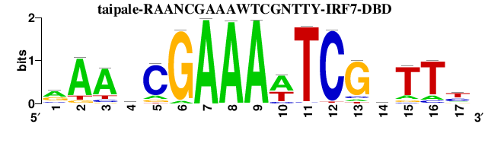
Real example: combinatory approach is needed
“iregulon” transcriptional factor prediction
p60 enriched 150 genes
129 TFs can bind
10 consensus TF binding sites
p60 enriched 150 genes
129 TFs
2
2 genes (Sox9 and Nr3c1, that are transcriptional enriched)

Slide 18
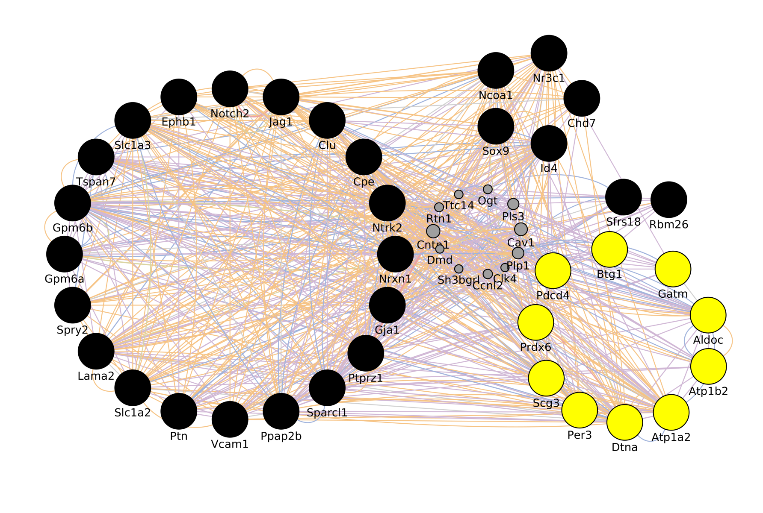
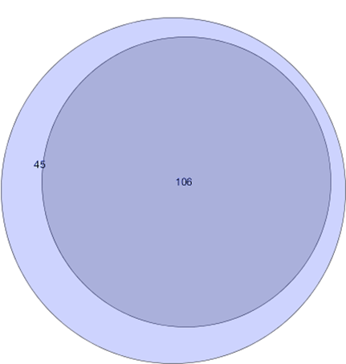
Interaction network analysis -- overrepresented network in potential Sox9 targets
Transcription
Epigenetics
106
Membrane
communication
potential Sox9 targets
metabolism
p60 NSC enriched genes
Network analysis of potential Sox9 targets

Slide 19
SCENIC
A combinatory approach is always preferred to reduce noise to increase the success rate.

Slide 20
SCENIC workflow and results

Slide 21
What do you achieve?

Slide 22
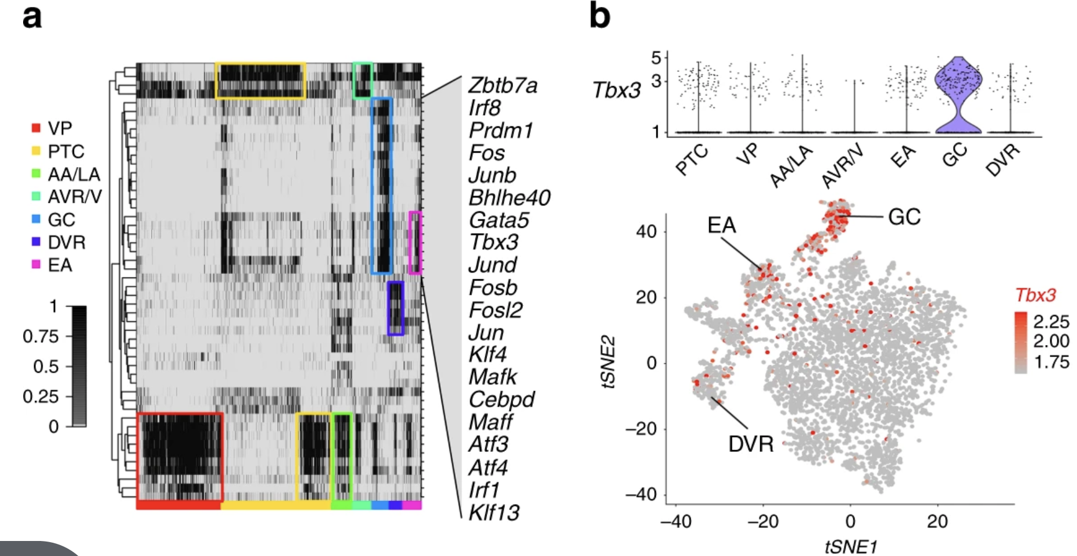
AUCell

Slide 23
Running SCENIC
Run the installation may spent 2 hrs.
Convert files to loom files. How
Download the cis-target file may take a long time. And how to set up these files before hand?
1.1 G for mm9 mouse. Take 30 minutes
Which page to use for a dry run before your own data.

Slide 24
Other resources
GraphPlot, http://juliagraphs.github.io/GraphPlot.jl/
Gamma distribution, https://towardsdatascience.com/gamma-distribution-intuition-derivation-and-examples-55f407423840
install.packages("igraph")
install.packages("bnlearn")
BiocManager::install("Rgraphviz")
iGraph for network analysis https://www.bioss.ac.uk/people/helen/igraphIntro.html
https://www.r-bloggers.com/interactive-network-visualization-with-r/

Slide 25
How to set up a tunel to server
install.packages('IRkernel') # Don’t forget step 2/2!
IRkernel::installspec()
using Pkg
Pkg.add("IJulia")
user@local_machine$ ssh -N -L localhost:8888:localhost:8888 user@remote_mahcine
Paste this to the url to access the Julia –”localhost:1234”

Slide 26
> tpm=read.table("S_GSE71485_Single_TPM.txt",row.names=1,header=T)
> Tpm=tpm[rowMeans(tpm)>100,]
> write.table(Tpm,"S_GSE71485_Single_TPM.txt")

Slide 27
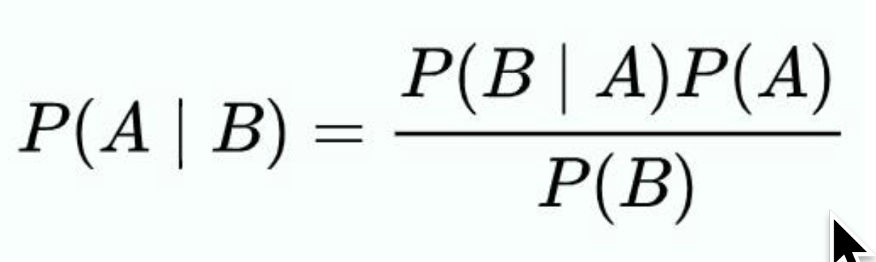
Parameters in Bayesian network
likelihood
prior
posterior
Evidence
posterior
likelihood
prior
$\text{P}\text{(}\text{cold}\text{|}\text{winter}\text{)=}\frac{P\left(winter | cold\right)P(cold)}{P(winter)}$ = $\frac{P\left(winter | cold\right)P(cold)}{P(winter)}$ = $\frac{100\%∗25\%}{25\%}$ =100%
Evidence

